Slide 1
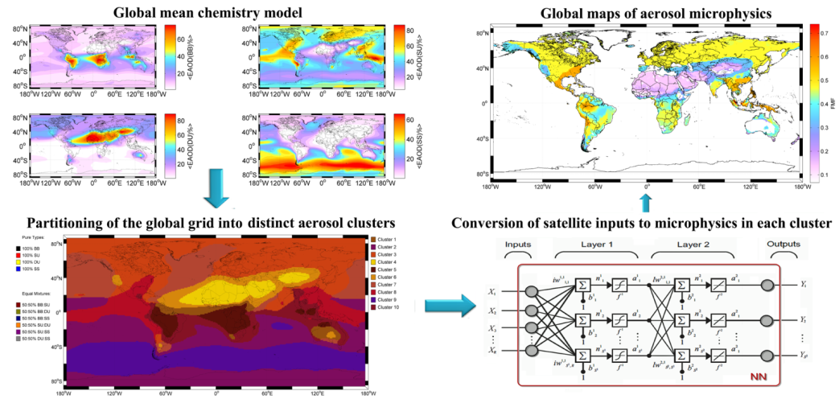
How a synergy of GOCART, MODIS and AERONET data can be used to train neural networks for producing global aerosol volume size distributions from space
Michael Taylor
National Observatory of Athens, Greece
mtaylor@noa.gr
2nd Gregory G. Leptoukh Online Giovanni Workshop:
November 13th, 2014 (Day 3): 10:00-11:00 (UTC/GMT-5)

Slide 2
OUTLINE:
Rationale – to train neural networks (NNs) to invert satellite measurements to retrieve daily aerosol size distributions and associated microphysics globally at 1x1 degree
Prototype – a NN model trained and tested for Saharan dust aerosol in Northern Africa
Global aerosol model – a 3-step approach:
STEP 1) application of cluster analysis to mean global GOCART aerosol optical depth data (per aerosol type) and identification of the composition & spatial distribution of aerosol mixtures at 1x1 degree
STEP 2) train a NN to invert satellite measurements for each aerosol mixture/region to produce global maps of size distributions
STEP 3) multimodal fitting & analysis of size distributions for determination of characteristic aerosol size & volume information
Case study - quasi-realtime monitor (4-day average) of the Karthala volcanic eruption 12-23 January, 2007
DATA: A word of thanks
Slide 1
Michael Taylor: mtaylor@noa.gr

Slide 3
DATA SOURCES: A word of thanks
A challenging experiment conducted on a single 16Gb RAM, quad-core PC with MATLAB:
From GIOVANNI 3 @NASA/GES-DISC: http://gdata1.sci.gsfc.nasa.gov
Aqua/MODIS (Level 3 Collection 5 daily global 1x1 gridded values): 16 parameters x 360 degrees x 180 degrees x 3575 days [34.4Gb]
Aura/OMI (Level 3 daily global 1x1 gridded values): 4 parameters x 360 degrees x 180 degrees x 3362 days [9.7Gb]
From GIOVANNI 4 @NASA/GES-DISC: http://giovanni.gsfc.nasa.gov/giovanni/
GOCART (Version 4): 5 parameters x 2.5 x 2 gridded values (interpolated to 1x1) x 7 years x 12 months
From AERONET: http://aeronet.gsfc.nasa.gov
160 aerosol optical & microphysical parameters (Levels 1.5 and 2.0/Version 2 Inversion Products) x 715,288 records (969 sites) [7.2Gb]
…which would not have been possible without the generous provision of open data by NASA/GES-DISC and the pioneering efforts of Gregory G. Leptoukh and co-workers to advance data interfacing, accessibility & visualization.
Slide 2
Michael Taylor: mtaylor@noa.gr

Slide 4
RATIONALE

Slide 5
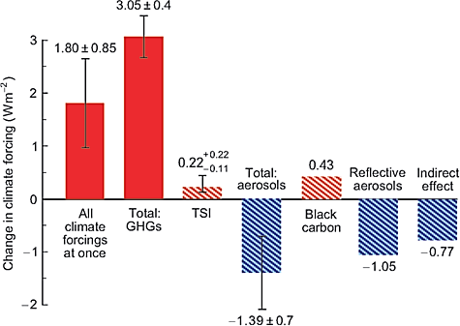
CONTEXT: There is a need to reduce uncertainty in aerosol climate forcing
GHG = Green-House Gases
TSI = Total Solar Irradiance
Estimated change for the period 1880-2003:
Aerosol uncertainty of ±0.7Wm⁻² >> that due to GHGs (0.4Wm⁻²)
Source: Mishchenko, M et al (2007) "Accurate monitoring of terrestrial aerosols and total solar irradiance: introducing the Glory Mission." Bulletin of the American Meteorological Society 88.5 (2007): 677-691.
Slide 3
Michael Taylor: mtaylor@noa.gr

Slide 6
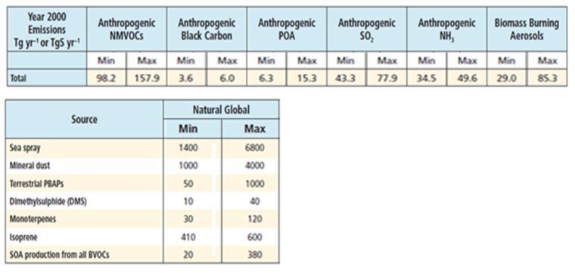
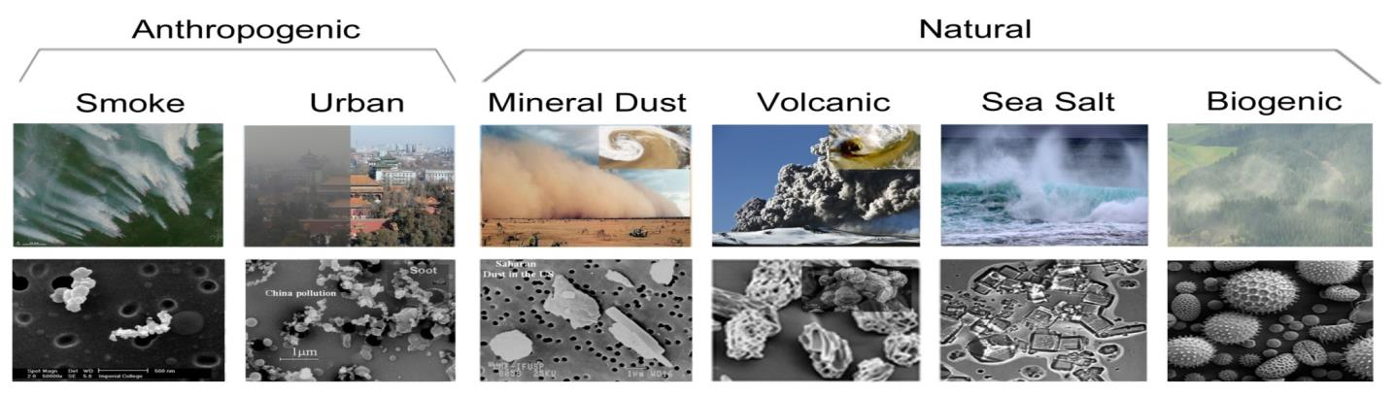
CONTEXT: Reducing uncertainty requires better aerosol characterization
Source: IPCC/AR5 (2013)
Dominant emissions are from deserts & oceans
Characterization = f (size, volume, shape, composition, source)
Slide 4
Michael Taylor: mtaylor@noa.gr

Slide 7
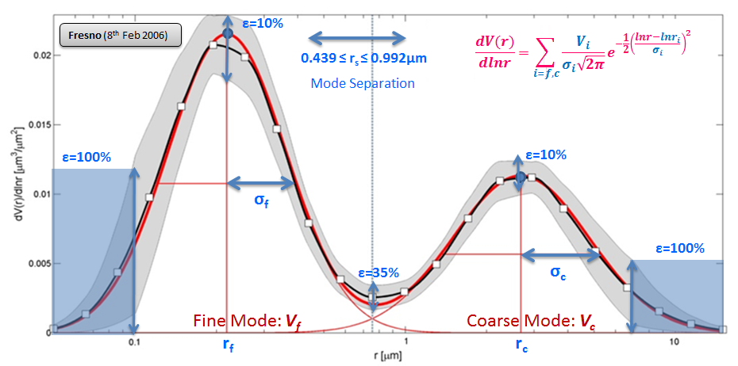
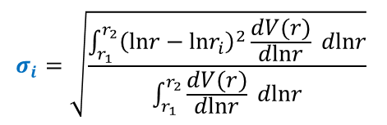
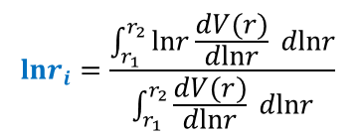
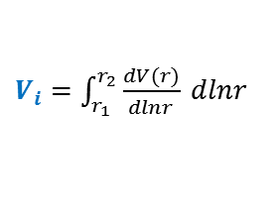
CONTEXT: Aerosol volume size distribution (AVSD) – AERONET method
Source (for ε): Dubovik et al (2000) JGR 105(D8), 9791-9806
$$lnr_{i}=\frac{\int_{r_{1}}^{r_{2}}{lnr\frac{dV(r)}{dlnr}} dlnr}{\int_{r_{1}}^{r_{2}}{\frac{dV(r)}{dlnr}} dlnr}$$
$$σ_{i}=\sqrt{\frac{\int_{r_{1}}^{r_{2}}{{\left(lnr−lnr_{i}\right)}^{2}\frac{dV(r)}{dlnr}} dlnr}{\int_{r_{1}}^{r_{2}}{\frac{dV(r)}{dlnr}} dlnr}}$$
$V_{i}=\int_{r_{1}}^{r_{2}}{\frac{dV(r)}{dlnr}} dlnr$
Source: Taylor, Kazadzis & Gerasopoulos (2014) Proceedings of the 12th International Conference on Meteorology, Climatology & Atmospheric Physics (COMECAP), Heraklion, Crete, 28-31 May, Vol. 3, 191-196.
Slide 5
Michael Taylor: mtaylor@noa.gr

Slide 8
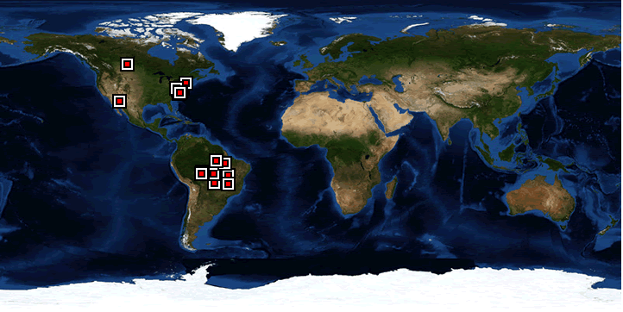
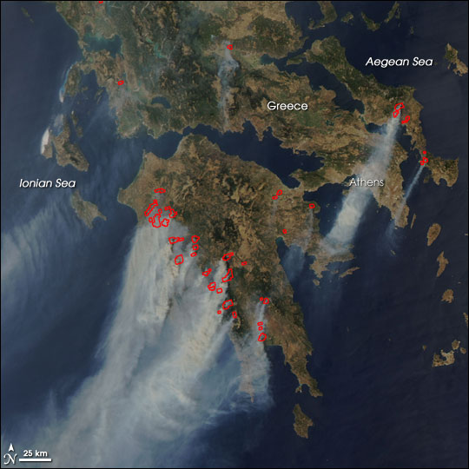
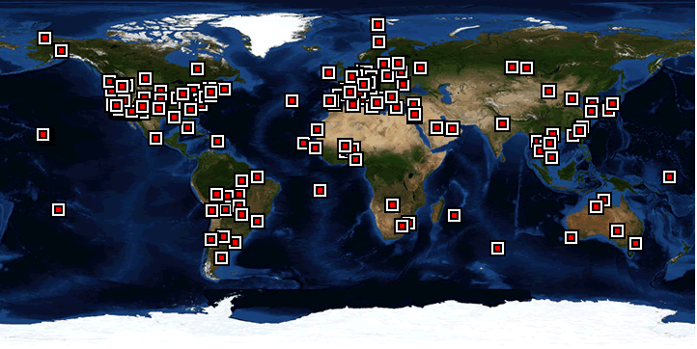
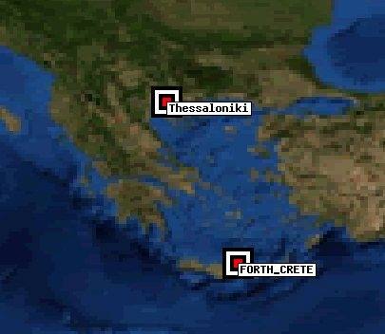
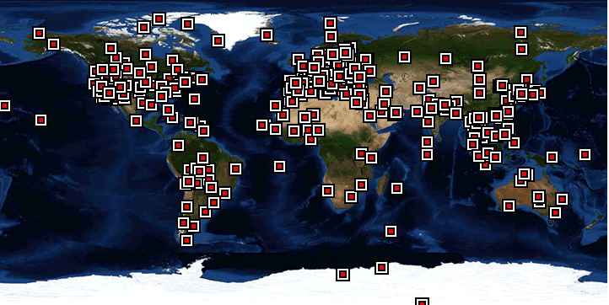
CHALLENGE: AERONET stations have inhomogeneous spatial coverage
Aerosol inversion products date back to 27 May, 1993 @GSFC
Wildfires in Greece (25 Aug 2007)
1993
Now >1000 sites…
… occupying only 343 pixels of the global grid (1x1 degree):
= 343/(360*180)
=0.54% membership of surface pixels
MODIS Rapid Response/LANCE
Source: http://earthobservatory.nasa.gov
2003
AERONET sites in Greece providing (Level 1.5) inversions during August 2007
2013
Source: http://aeronet.gsfc.nasa.gov
Source: http://aeronet.gsfc.nasa.gov
Slide 6
Michael Taylor: mtaylor@noa.gr

Slide 9
IDEA: Retrieve AERONET parameters by inverting SATELLITE measurements
MODIS H2O (to cloud)
MODIS AOD (470nm)
MODIS AOD (550nm)
MODIS AOD (660nm)
OMI AOD (380nm)
OMI AOD (500nm)
OMI AAOD (500nm)
Satellite inputs
(gridded 1x1 degree)
From: Giovanni 3
H2O=Precipitble water vapour
AOD=Aerosol optical depth
AAOD=Absorption AOD
AVSD=Aerosol volume size distribution
CRI-R=Complex refractive index (real part)
CRI-R=Complex refractive index (imaginary part)
SSA=Single scattering albedo
ASYM=asymmetry factor
Function
Approximator
Neural Network (NN)
AVSD (22 radial bins)
CRI-R (440, 675, 870, 1020nm)
CRI-I (440, 675, 870, 1020nm)
SSA (440, 675, 870, 1020nm)
ASYM (440, 675, 870, 1020nm)
“AERONET” outputs
(gridded 1x1 degree)
From: AERONET
Slide 7
Michael Taylor: mtaylor@noa.gr

Slide 10
PROTOTYPE:
A NN model for retrieval of Saharan Dust size distributions in Northern Africa

Slide 11
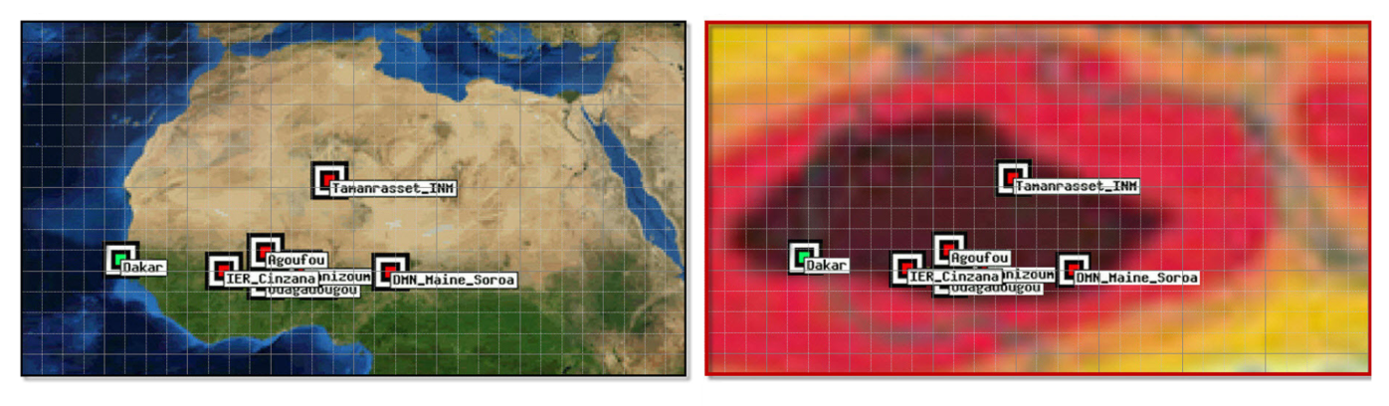
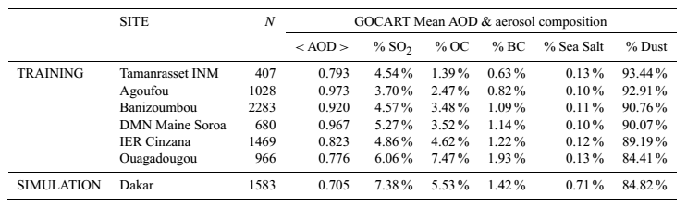
DATA: GOCART-selected Northern African “dust” sites for the NN model
Training Sites
GOCART mean dust AOD
Test Site
Source: Taylor, M., Kazadzis, S., Tsekeri, A., Gkikas, A., Amiridis, V. (2014) Satellite retrieval of aerosol microphysical and optical parameters using neural networks: a new methodology applied to the Sahara desert dust peak. Atmospheric Measurement Techniques 7, 3151-3175.
Slide 8
Michael Taylor: mtaylor@noa.gr

Slide 12
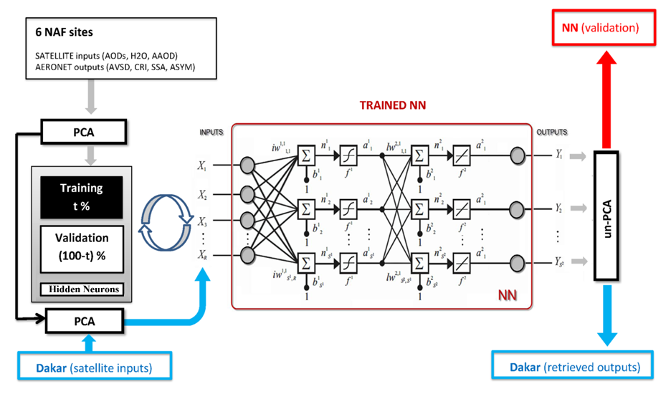
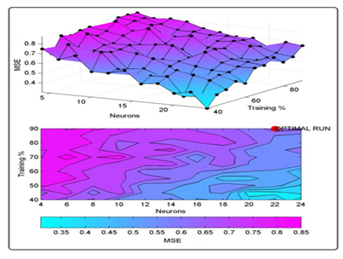
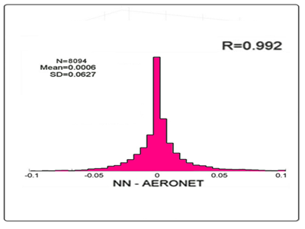
NN MODEL: Scheme for objectivizing the NN architecture
A grid of 100 NNs were trained:
Training fraction (t%) = [40%:5%:90%]
Tanh hidden neurons = [4:2:24]
Minimum mean squared error → Optimal NN
Source: Taylor et al (2014) AMT 7, 3151-3175
PCA = Principal Components Analysis (98% variance)
Slide 9
Michael Taylor: mtaylor@noa.gr

Slide 13
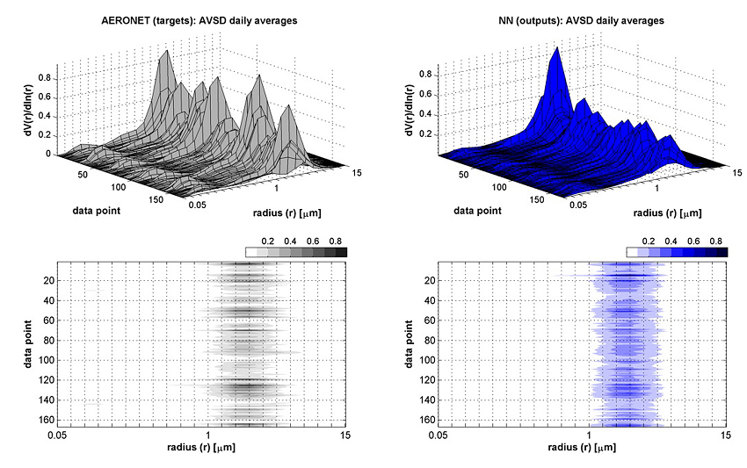
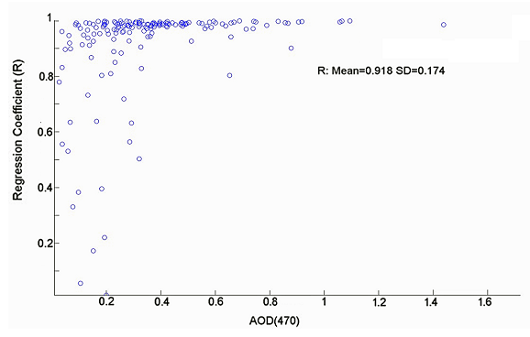
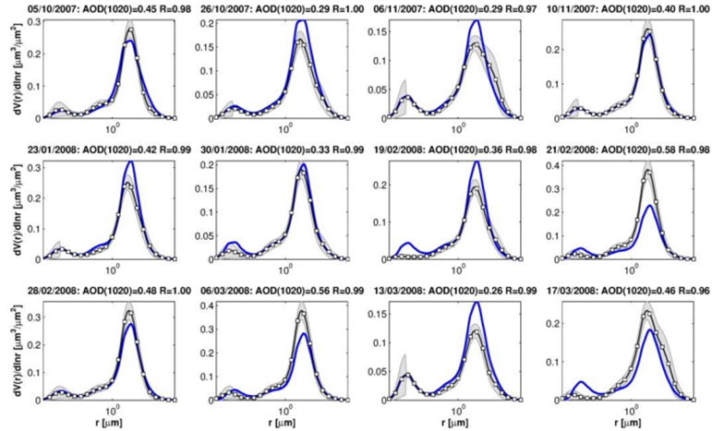
NN SIMULATION (Dakar): AVSD (181 co-located daily averages)
Good daily retrieval of the AVSD
for Saharan dust (only)
Source: Taylor, M et al (2014) AMT 7, 3151-3175
Slide 10
Michael Taylor: mtaylor@noa.gr

Slide 14
GLOBAL AEROSOL MODEL

Slide 15
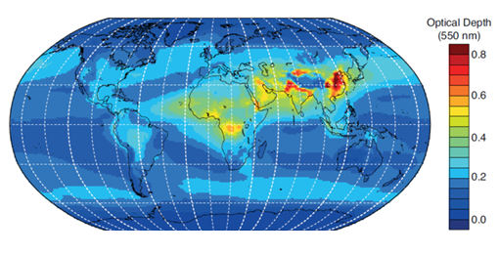
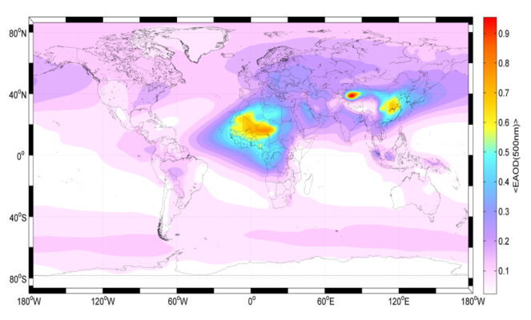
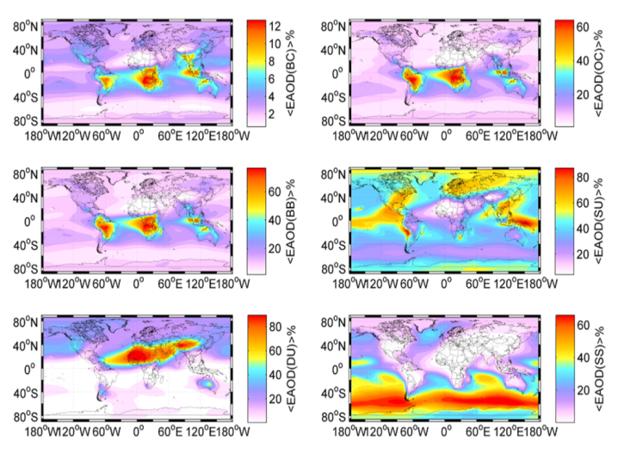
STEP 1: Use GOCART to partition by mean aerosol type mixture
GOCART mean AOD(550) averaged from
3-hr simulations between 2000-2007
(http://acd-ext.gsfc.nasa.gov/People/Chin/gocartinfo.html)
Source: IPCC/AR5 (2013)
GOCART 2000-2007 global mean AOD per type :
(BC, OC, SU, DU, SS)
BC=Black Carbon
OC=Organic Carbon
SU=Sulfate
DU=Dust
SS=Sea Salt
Source: MT
Slide 11
Michael Taylor: mtaylor@noa.gr

Slide 16
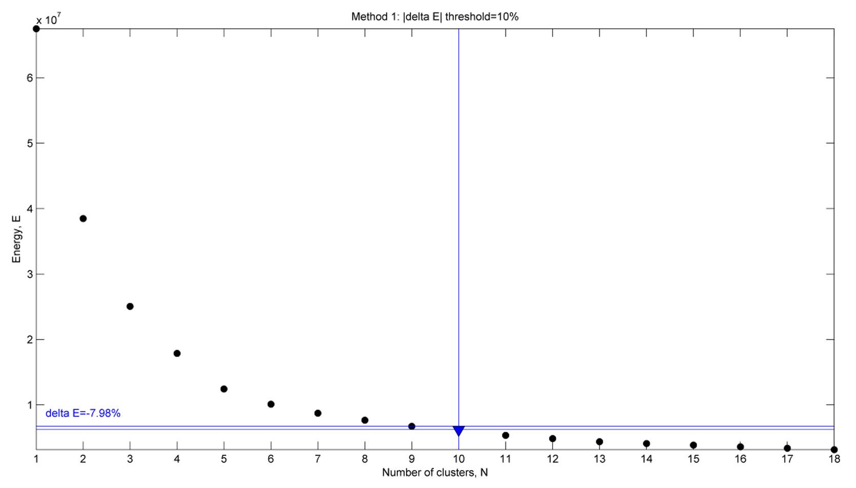
CLUSTER ANALYSIS: of GOCART AOD (BB=BC+OC, SU, DU, SS)
Global partition into 10 aerosol mixtures
Add clusters (10 random seeds each time) until cluster centers do not change by > 10%
Slide 12
Michael Taylor: mtaylor@noa.gr

Slide 17
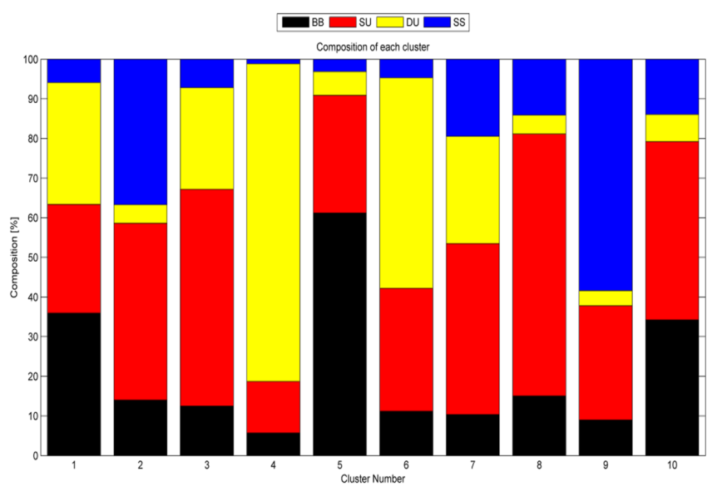
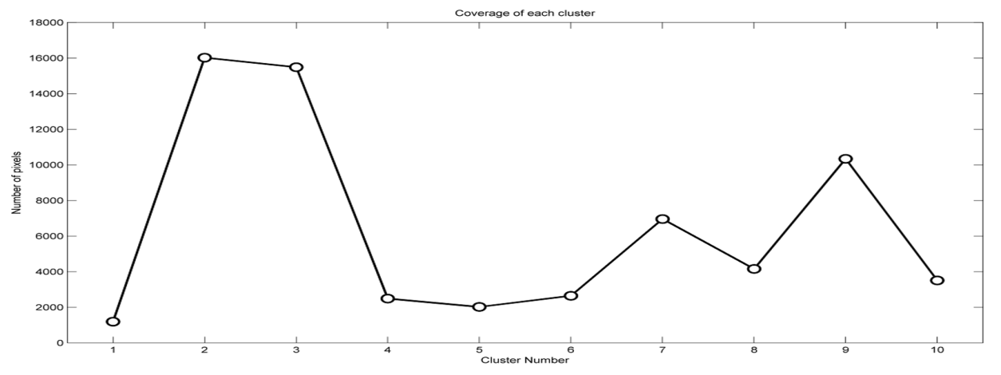
CLUSTER ANALYSIS: Composition of 10 aerosol mixtures
Cluster 1 = Dusty Sulfurous SMOKE
Cluster 2 = Marine SULFATE
Cluster 3 = Dusty SULFATE
Cluster 4 = DUST
Cluster 5 = Sulfurous SMOKE
Cluster 6 = Sulfurous DUST
Cluster 7 = Dusty Marine SULFATE
Cluster 8 = SULFATE
Cluster 9 = Sulfurous MARINE
Cluster 10 = Smokey SULFATE
Minimum cluster coverage > 1000 pixels (1x1 degree)
Slide 13
Michael Taylor: mtaylor@noa.gr

Slide 18
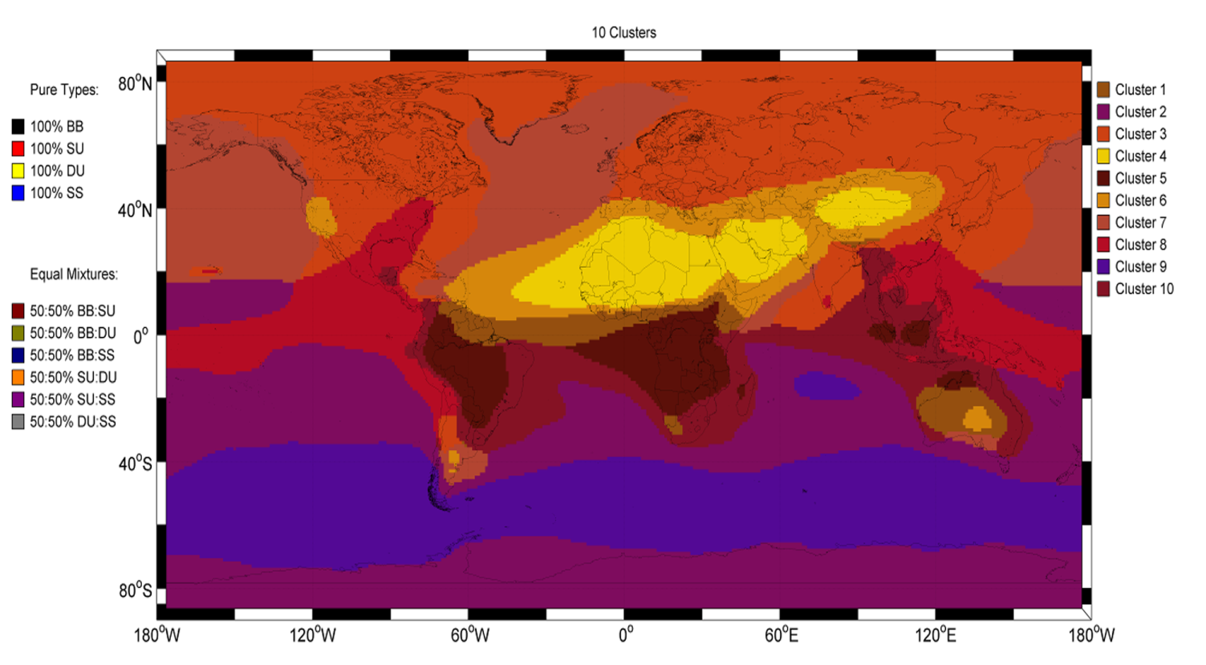
CLUSTER ANALYSIS: Colour-mixed global mean aerosol partitions
This colour scheme may help in visually interpreting aerosol mixtures
Slide 14
Michael Taylor: mtaylor@noa.gr

Slide 19
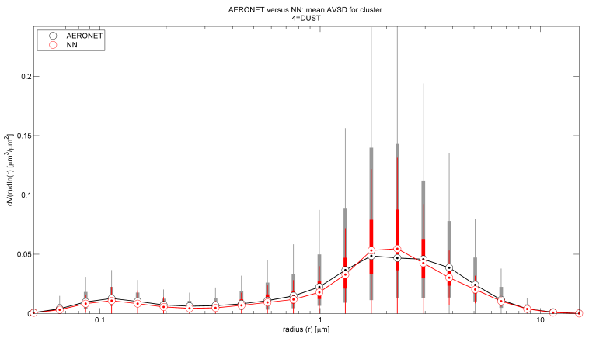
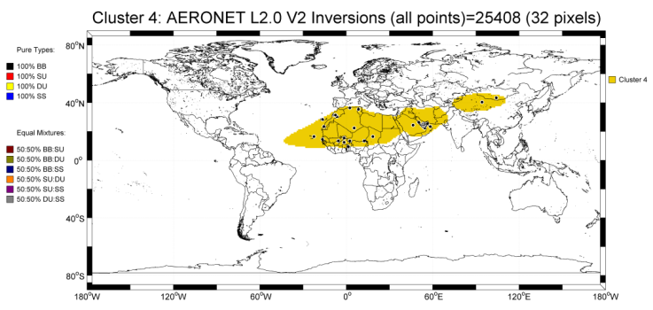
STEP 2: Use co-located Satellite/AERONET data to train a NN for each cluster
Slide 15
Michael Taylor: mtaylor@noa.gr

Slide 20
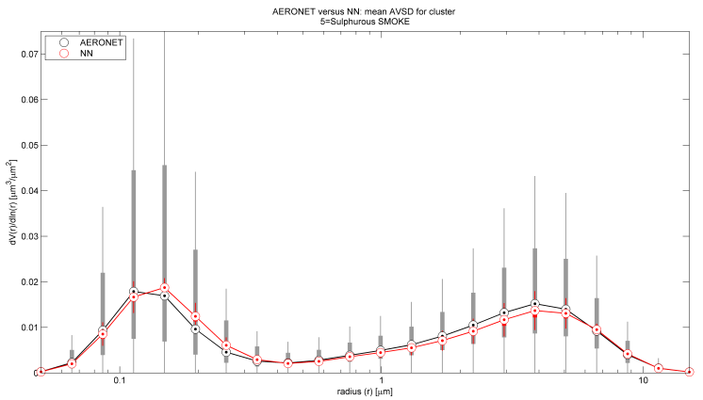
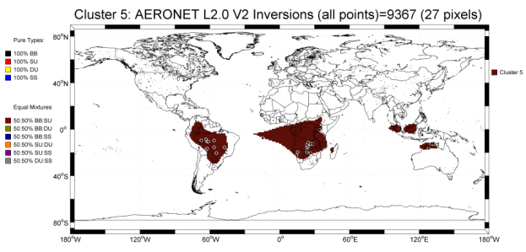
RESULTS: The biomass burning cluster 5 (“Sulfurous SMOKE”)
Slide 16
Michael Taylor: mtaylor@noa.gr

Slide 21
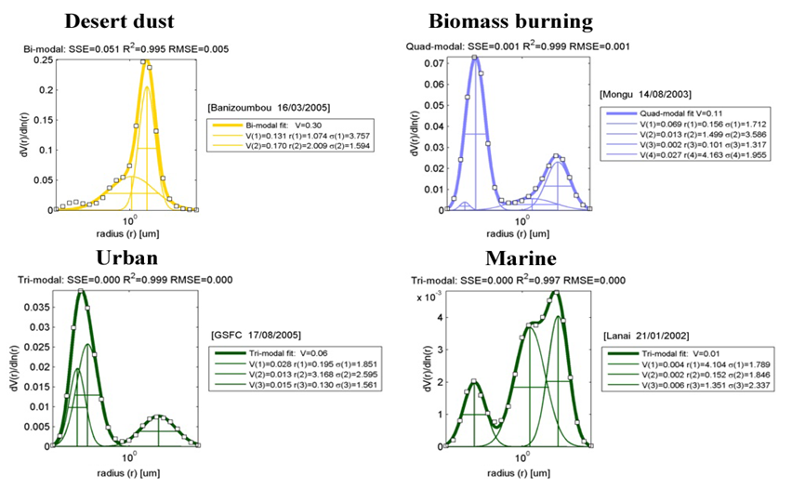
STEP 3: Multimodal fitting & analysis → additional size & volume info
Source: Taylor, Kazadzis, Gerasopoulos (2014) Multi-modal analysis of aerosol robotic network size distributions for remote sensing applications: dominant aerosol type cases. Atmospheric Measurement Techniques 7, 839-858AMT 7, 839-858
Slide 17
Michael Taylor: mtaylor@noa.gr

Slide 22
CASE STUDY:
Quasi-real time monitoring of the Karthala Volcano Eruption
(12-23 January, 2007)

Slide 23
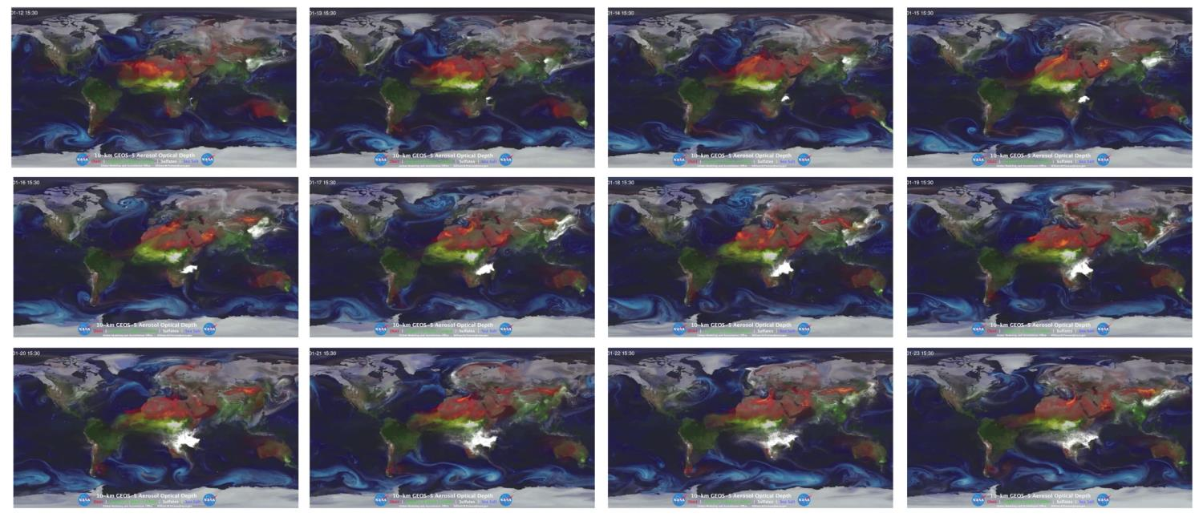
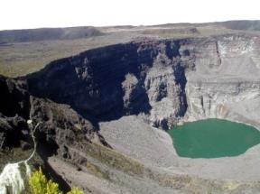
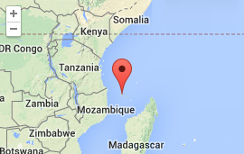
GOCART DATA: Composite maps (BB, SU, DU and SS)
Karthala (Grande Comore Island)
Shield volcano eruption (VEI=2):
12-23 January, 2007
GOCART daily-averaged composite AOD
(BB=green, SU=white, DU=orange, SS=blue)
Slide 18
Michael Taylor: mtaylor@noa.gr

Slide 24
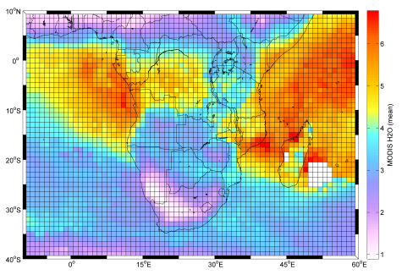
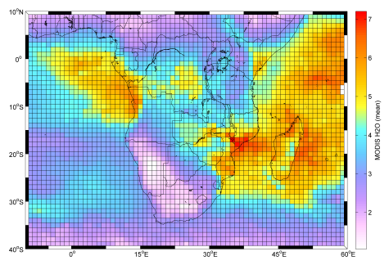
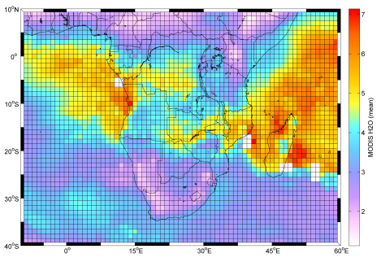
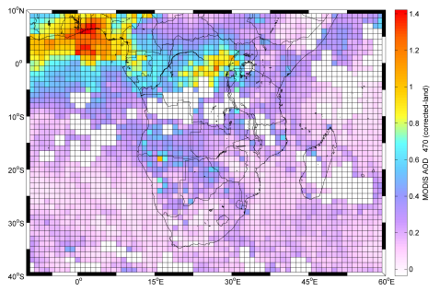
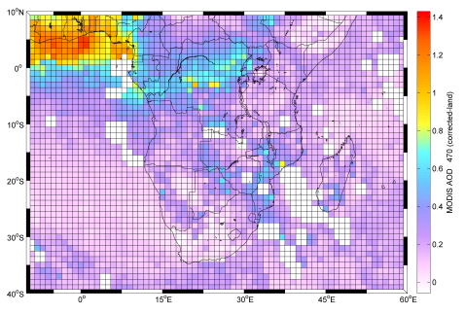
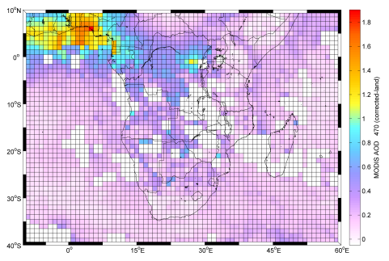
SATELLITE INPUTS: 4-day average (to smooth out “patchiness”)
12-15 Jan 2007
16-19 Jan 2007
20-23 Jan 2007
MODIS: H2O
MODIS: H2O
MODIS: H2O
MODIS: AOD(470nm)
MODIS: AOD(470nm)
MODIS: AOD(470nm)
Slide 19
Michael Taylor: mtaylor@noa.gr

Slide 25
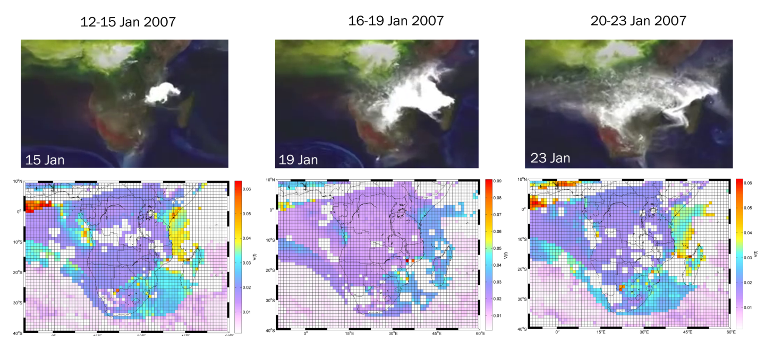
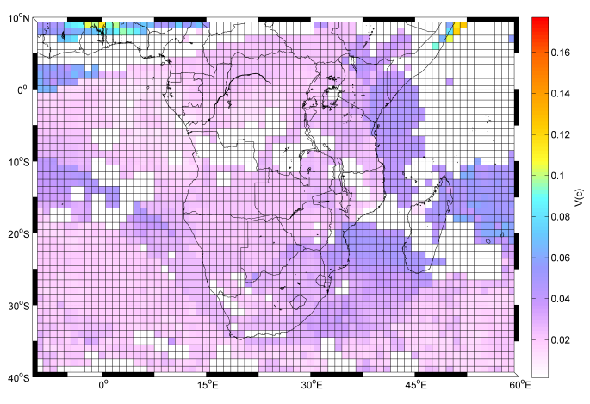
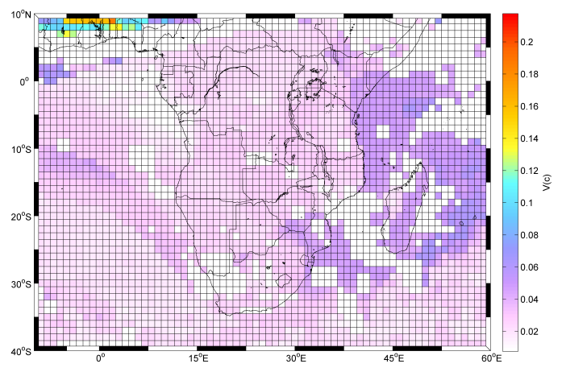
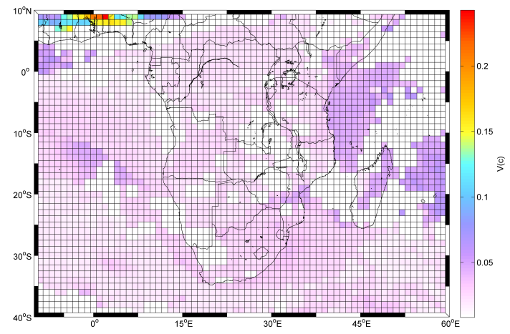
4-DAY AVERAGE: Quasi-realtime 1x1 degree grid of microphysics
V(f)
V(f)
V(f)
V(c)
V(c)
V(c)
Slide 20
Michael Taylor: mtaylor@noa.gr

Slide 26
SUMMARY:
Prototype model → it is possible to train NNs to invert satellite measurements to provide daily retrievals of the aerosol volume size distribution at 1x1 degree resolution
Global aerosol model → 1) Mean global GOCART AOD (per type) can be used to identify 10 clearly defined aerosol mixtures/partitions, 2) partitions allow extraction of co-located Satellite/AERONET data for training of aerosol mixture/region-dependent NNs, 3) Multimodal fitting & analysis of AVSDs can provide detailed size & volume information
Case study → quasi-realtime 1x1 degree maps of size distribution-derived microphysics can be produced at the 4-day timescale
Many thanks to:
@NOA: Stelios Kazadzis, Vangelis Gerasopoulos, Alexandra Tsekeri, Vasilis Amiridis and
@BSC/Earth Science: Antonis Gikas (for their co-authorship of articles)
@AERONET: PIs (for maintenance & provision of HQ open data inversion products)
@NASA/GES-DISC: Giovanni 3 & 4 PIs (for maintenance & provision of HQ open data from MODIS/Aqua, OMI/Aura and GOCART 4)
@ADNET SYSTEMS INC: Jennifer Brennan & Jim Acker for kindly organizing this workshop
Slide 21
Michael Taylor: mtaylor@noa.gr

